Slide 1
Module: Reverse Engineering
Examples of Reverse Engineering
Yan Shoshitaishvili
Arizona State University

Slide 2
License Checkers
Back in the stone age, before every cave had internet access, software had to be installable without internet access.
How does the software ensure that it is legitimate?
License key checks!
Have a secret algorithm that takes in input, performs some calculation, and validates the result.
Ideally, the company selling the software can generate multiple valid keys.
Ideally, pirates cannot generate valid keys.
This method implicitly trusts the binary code to keep the secret license key verification algorithm safe!

Slide 3
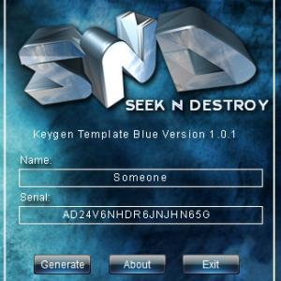
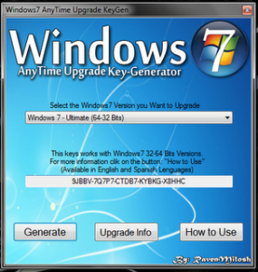
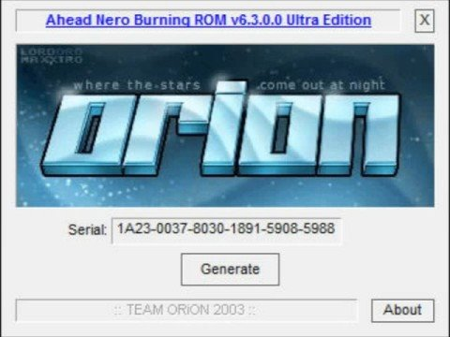


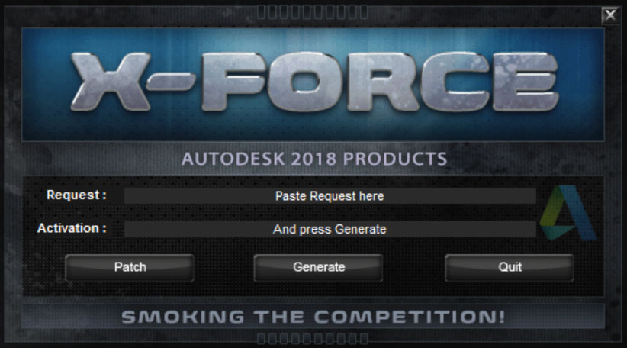
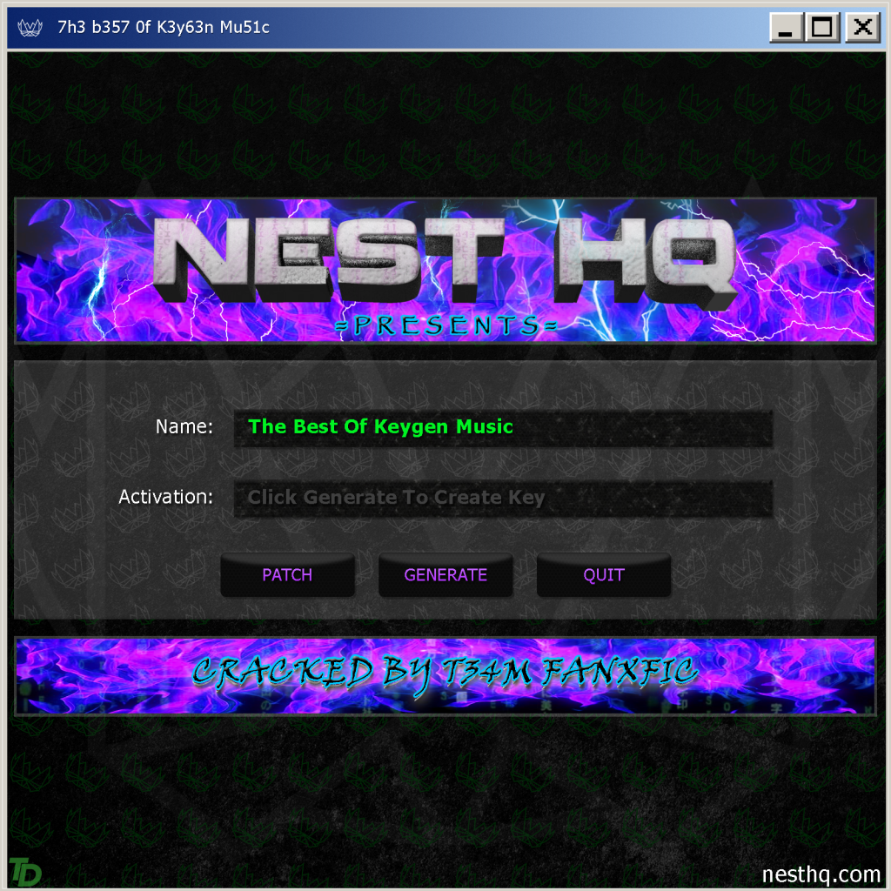
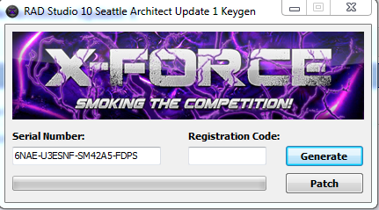
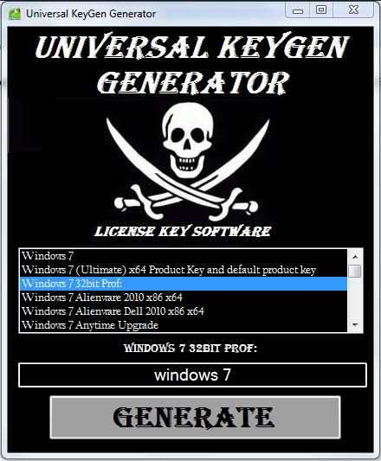
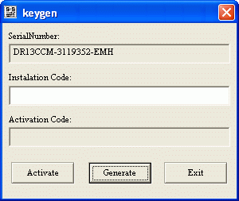

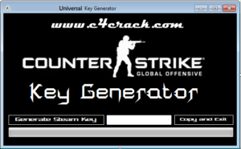
The Rise of Keygens

Slide 4

The Rise of Keygens

Slide 5
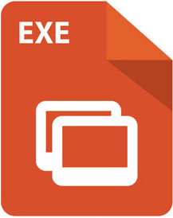
Reverse Engineering - Simple Example
Understand
Crackmes are small programs designed to test a hacker's reverse engineering skillz.
Inspired by real-world license key verification systems.
Lots of Thinking
Decompile
Disassemble
Crackme: https://en.wikipedia.org/wiki/Crackme
Many many crackmes: https://crackmes.one

Slide 6
Alternatives to Keygens
With ubiquitous internet access (and increased ability to have unbreakable server-side license key checks), keygenning diminished in viability.
Alternatives:
Cracks that patch the executable to remove the check altogether (but what to crack?).
Legally purchasing the software.

Slide 7
Evolution of DRM
Modern DRM has taken on more and more clever approaches, such as:
Anti-debugging: techniques to fight dynamic analysis
VMing: wrapping the DRM code in a heavily obfuscated, protected emulator for a custom architecture, with the DRM logic inside that architecture.
Trusted Execution Environments: moving the DRM outside of the CPU into protected hardware.

Slide 8
Reverse Engineering for Modding
Another application of reverse engineering: modding. When modders hit the limits of modding a game's data files, they start modding the code.
Examples:
Skyrim: the Skyrim Script Engine (SKSE)
Dwarf Fortress: DFHack
And the dark side: cheating in online games.

